Slide 1
SEER*DMS CCB
April 13, 2017
Moderators:
Linda Coyle
Marina Matatova

Slide 2

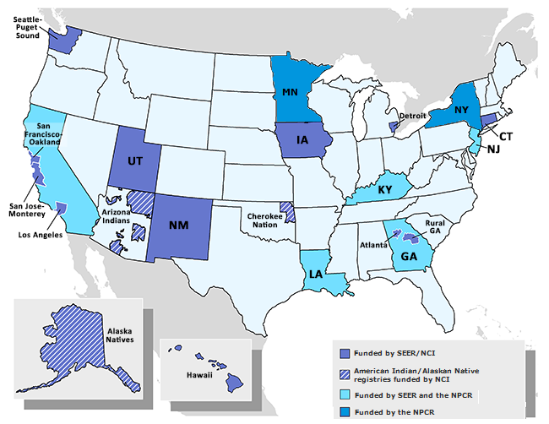
SEER*DMS Registries
2005
Metropolitan Detroit CSS
2006
Connecticut Tumor Registry
Hawaii Tumor Registry
New Mexico Tumor Registry
2007
Alaska Native Tumor Registry
Cherokee Nation Cancer Program
State Health Registry of Iowa
2008
2009
Louisiana Tumor Registry
2010
Seattle Cancer Surveillance System
2011
Utah Cancer Registry
2012
Georgia Center for Cancer Statistics
IMS
2013
New Jersey State Cancer Registry
NCI
2016
New York State Cancer Registry
SCG
2017
Minnesota Cancer Surveillance System
2018
Kentucky Cancer Registry

Slide 3
Updates - CCB Workgroups

Slide 4
MU2 Workgroup
2006
Connecticut Tumor Registry
Hawaii Tumor Registry
New Mexico Tumor Registry
2007
State Health Registry of Iowa
2008
2009
Louisiana Tumor Registry
2011
Utah Cancer Registry
2012
Georgia Center for Cancer Statistics
Group Leader:
Brent Mumphrey (LTR)
2013
New Jersey State Cancer Registry
2016
New York State Cancer System

Slide 5
Status Report – MU2
IMS staff have been making changes to DMS to load MU2 data into the “pre_record” table.
  Add the CDA import
  Load into pre_record table
  Use queries to identify patients in MU2 data that are not Patient Sets
  Use queries to identify new cases for existing patient sets.
Registries will review the data in DMS when IMS completes this task.
Next meeting: Thursday, April 27th

Slide 6
Claims Workgroup
New Mexico Tumor Registry
2007
2011
Utah Cancer Registry
2012
Georgia Center for Cancer Statistics
Group Leader:
Kevin Ward (GA)
2013
New Jersey State Cancer Registry
2018
Kentucky Cancer Registry

Slide 7
Data Sources – SEER*DMS Registries
Standard sources of medical data:
Hospitals
Pathology Laboratories
Cancer Treatment Facilities
Physician Practices
Clinics
Nursing Homes/Hospices
Other Cancer Registries
Diagnostic Imaging Centers
Insurance Claims
Pharmacy Data
Genetic Information
Physician Reports
New data streams for SEER*DMS registries are expected to include:

Slide 8
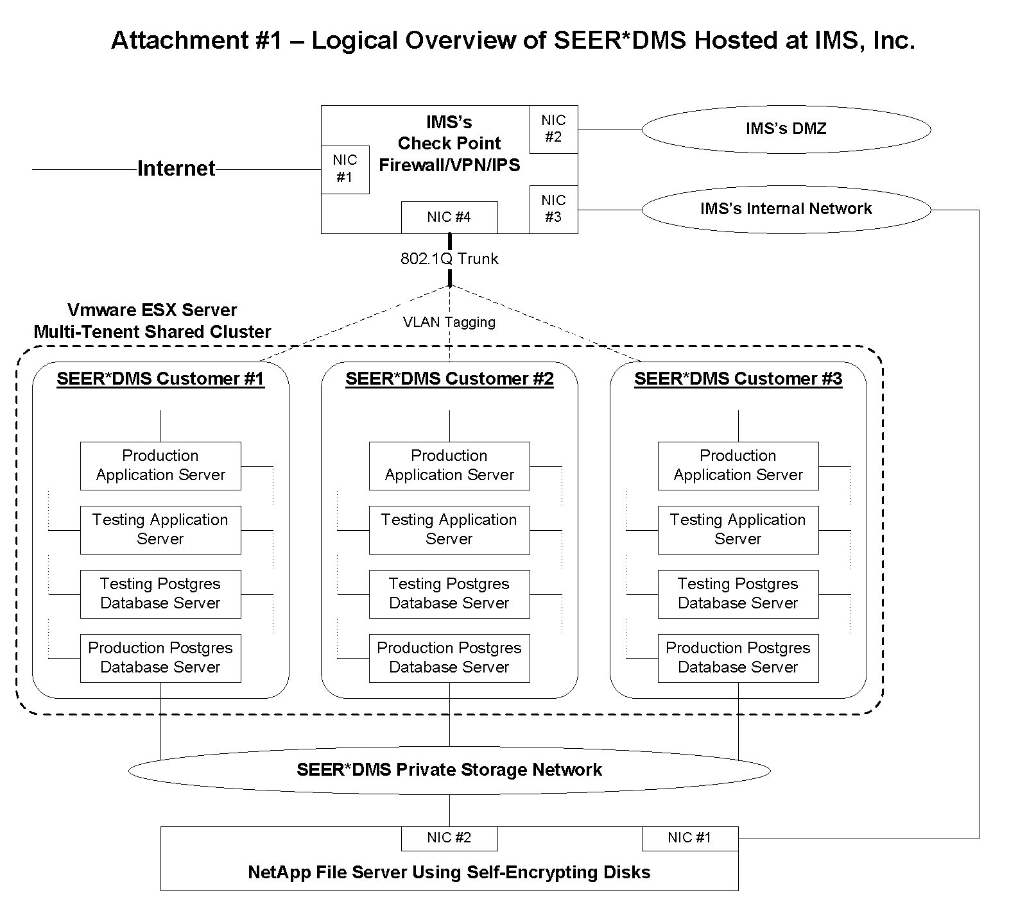
Registry enclaves in the data center can be expanded – to support additional applications.

Slide 9
Data Transmissions to SEER*DMS
Standard method:
  Organization sends data to registry’s local environment
  Registry transmits data to SEER*DMS autoloader; or staff upload data via the SEER*DMS application
This is the recommended method for local and regional data sources (hospitals, path labs, etc).
Hospital, Path Lab
Registry
SEER*DMS

Slide 10
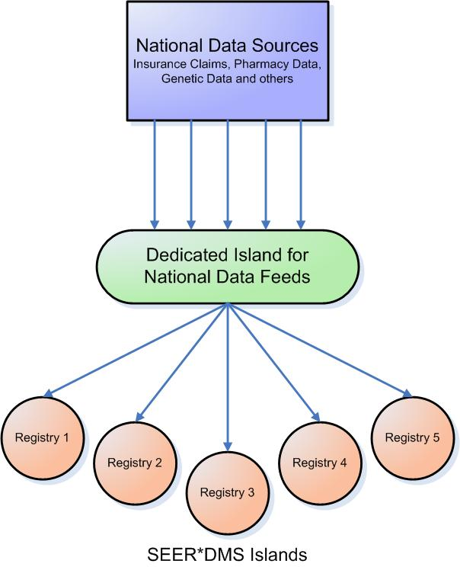
Making National Data Available to Registries
National organizations can stream data to a single, dedicated island in an IMS computer center
This island is stand alone; cordoned off from everything else by a firewall
An IMS-maintained service transfers data from the data feed island to the appropriate registry island

Slide 11
Making National Data Available to Registries
Unlimited Systems is now transmitting data for 5 registries (as of March 2017).
Requirements:
  A single agreement between IMS and Unlimited Systems. A similar agreement would need to be made with each national organization.
  An amendment to the Connection Agreement between IMS and the registry. The intent is for this to cover all national data sources.
Benefits:
  Saves time and effort for each registry in terms of infrastructure to receive and transmit data.
  National organizations are more likely to onboard – less hassle dealing with one entity (IMS) instead of 4 to 15 registries.

Slide 12
Workflow for High Volume Data
Import
Data
Load data into “PRE_RECORD” table. Data stored in JSON format.
Match to
Database
Match against Patient Sets
Code
Fields
Perform some standardization of the data: address normalization; conversion to ICD-O-3 codes, etc.
Use SEER MP/H rules for tumor level matching
Sample file formats: ANSI 837 – 5010A for Claims; CDA for MU2 data
Evaluate
Targeted review of data – identify cases for manual review. Example: Manually update treatment data for cases identified via data searches
Define Automation
Based on the manual evaluation and data analysis, define business rules for auto-processing the data. For example, automatically code chemo fields based on claims data.
JSON – self-describing; and well-suited for the multi-level data in claims and other data. One JSON definition for claims; another for MU2, etc
This workflow is currently being
used for claims in GA.
The same principles will be used to evaluate other data sources

Slide 13
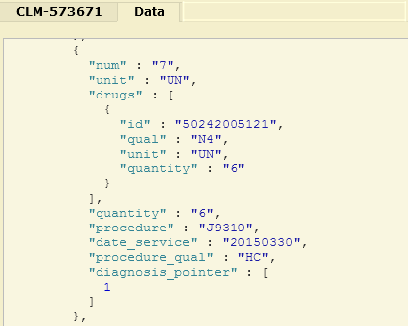


JSON Data Structure
Advantages:
  Adding a field is much easier.
  JSON object is one column in the “pre_record” table
  Same table can be used for different data types; the JSON column differs by type
Disadvantage:
  It is harder for typical users to query using SQL. IMS will provide viewers and data searches.
This claim indicates chemo was administered on 03-30-2015. J9310 = Rituximab injection.

Slide 14
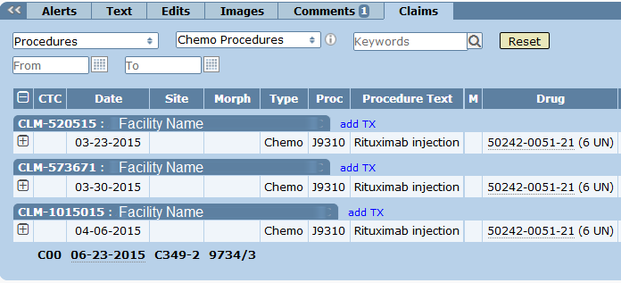
SEER*DMS Claims Viewer
JSON viewer is available – primarily for IMS staff to resolve issues.
Registrars see the Claims Viewer in the right panel of the Patient Set editor.

Slide 15
Claims Workgroup
Registries receiving claims data:
  Georgia
  Kentucky
  New Jersey
  New Mexico
  Utah
IMS will import claims on the registry’s DEV servers. (Excluding GA – claims are live in GA)
Next step - schedule a kickoff meeting

Slide 16
Auto-linking Workgroup
Hawaii Tumor Registry
2007
Alaska Native Tumor Registry
2008
2011
Utah Cancer Registry
2012
Georgia Center for Cancer Statistics
Group Leader:
Linda Coyle (IMS)
2016
New York State Cancer Registry

Slide 17
Auto-linking Workgroup
IMS changed workflow for the participating registries on their DEV servers.
Dev servers were reloaded because of server maintenance; these are being re-deployed today.
Recommend
  Review data for next few weeks
  Meet in May

Slide 18
Auto-cons Workgroup
2005
Metropolitan Detroit CSS
State Health Registry of Iowa
2008
2009
Louisiana Tumor Registry
2011
Utah Cancer Registry
Group Leaders:
Bobbi Matt (IA)
Frances Ross (KY)
2013
New Jersey State Cancer Registry
2018
Kentucky Cancer Registry

Slide 19
Auto-cons Workgroup - Update
1st meeting is scheduled for May 9, 2017
In the meantime, IMS staff have been meeting to review technical implementation.

Slide 20
Productivity Reports
Reminder:
  Team registries were asked to define use cases for productivity reports. Please update Squish 5241.
Seattle and Georgia presented reports in the March meeting. Other registries will discuss their productivity measures in the next meeting.
IMS staff implemented a “new” productivity report for managers to review. RPT-153. Changes were made based on the March meeting. We will review it again in April.
Next meeting: April 20th

Slide 21
SEER*DMS Meeting
The SEER*DMS in-person meeting will be held July 12-14, 2017.
Save the date…
Agenda and hotel recommendations coming soon

Slide 22
Physician Addresses
Physicians work at multiple locations.
Physicians are stored in the SEER*DMS Contact list.
In 2015:
  CCB considered adding multiple addresses to the Contact list for physicians.
  It was decided that registries would try using the facility list. One facility for each of the physician’s practices.
  For each physician, create a list of facility affiliations in the Contact Editor.
Is this solution working?

Slide 23
Physician Addresses
If a change is needed to the way that physician addresses are stored, we should review the business rules.
  Are these addresses used for follow-back?
  What other reasons do you use physician addresses/
  How do you select an address when a doctor has multiple addresses?
  Do you consider a facility coded in the record or CTC?
  What other questions should we consider?
Please update Squish 5262 with your registry’s information.

Slide 24
Census Block
See Squish 5111
Census block field was changed from 1 char to 4 char in 2012.
Data were not updated at that time.
In 2017, IMS added ability to update missing or incomplete geocoding fields. Therefore, a system task can be run to convert from 1 char to 4 char block.
Each registry should review issue 5111 and indicate if you want IMS help to run the geocoding task; and review changes with your staff.

Slide 25
CCB Meeting Topics – May 2017
Site-specific factors – DMS configurations for displaying SSFs for different years of diagnosis
Registry discussion related to processing that registries do before loading data into SEER*DMS.
Please submit other CCB topics via Squish or email!

