Slide 1
SEER*DMS CCB
May 11, 2017
Moderators:
Linda Coyle
Marina Matatova

Slide 2

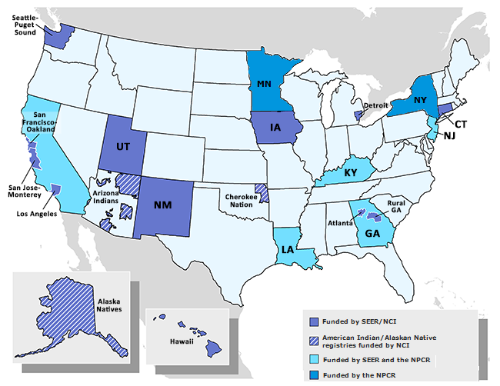
SEER*DMS Registries
2005
Metropolitan Detroit CSS
2006
Connecticut Tumor Registry
Hawaii Tumor Registry
New Mexico Tumor Registry
2007
Alaska Native Tumor Registry
Cherokee Nation Cancer Program
State Health Registry of Iowa
2008
2009
Louisiana Tumor Registry
2010
Seattle Cancer Surveillance System
2011
Utah Cancer Registry
2012
Georgia Center for Cancer Statistics
IMS
2013
New Jersey State Cancer Registry
NCI
2016
New York State Cancer Registry
SCG
2017
Minnesota Cancer Surveillance System
2018
Kentucky Cancer Registry

Slide 3
Updates - CCB Workgroups

Slide 4
MU2 Workgroup
2006
Connecticut Tumor Registry
Hawaii Tumor Registry
New Mexico Tumor Registry
2007
State Health Registry of Iowa
2008
2009
Louisiana Tumor Registry
2011
Utah Cancer Registry
2012
Georgia Center for Cancer Statistics
Group Leader:
Brent Mumphrey (LTR)
2013
New Jersey State Cancer Registry
2016
New York State Cancer System

Slide 5
Status Report – MU2
A Squish “group” was created for the MU2 workgroup. Use it to notify others in the group on MU2 issues.
Summary of Action Items from April 27, 2017:
  Detailed list of action items listed in Squish 5344.
  IMS staff - continue development. This includes JSON mappings; and developing a “strawman” viewer.
  IMS staff - provide statistics to the group
  Registries – review eMarc List. Highlight fields not needed. Send to Brent
  Brent – compile field lists.
Next Meeting: Thursday, May 25th

Slide 6
Claims Workgroup
New Mexico Tumor Registry
2007
2011
Utah Cancer Registry
2012
Georgia Center for Cancer Statistics
Group Leader:
Kevin Ward (GA)
2013
New Jersey State Cancer Registry
2018
Kentucky Cancer Registry

Slide 7
Claims Workgroup
In the April CCB meeting, we reviewed the Claims workflow.
Our action item from the April CCB meeting was to schedule a kickoff meeting for the full claims workgroup.
Workgroup meetings were scheduled for 3rd Monday of the Month. Next meeting:
  May 15, 2017 at 11 am ET.

Slide 8
Auto-linking Workgroup
Hawaii Tumor Registry
2007
Alaska Native Tumor Registry
2008
2011
Utah Cancer Registry
2012
Georgia Center for Cancer Statistics
Group Leader:
Linda Coyle (IMS)
2016
New York State Cancer Registry

Slide 9
Auto-linking Workgroup
IMS made additional changes to controls related to auto-linking.
  A configuration parameter was added. It controls whether a TX is auto-built when a record is auto-linked.
  All auto-linking logic can be implemented in routing scripts.
These changes were made so that registry test servers can be used to evaluate linkage. We do not need to use DEV servers.
IMS will work with each registry to review linkages on their test servers.

Slide 10
Auto-cons Workgroup
2005
Metropolitan Detroit CSS
State Health Registry of Iowa
2008
2009
Louisiana Tumor Registry
2011
Utah Cancer Registry
Group Leaders:
Bobbi Matt (IA)
Frances Ross (KY)
2013
New Jersey State Cancer Registry
2018
Kentucky Cancer Registry

Slide 11
Auto-cons Workgroup - Update
Frances Ross (KY) and Bobbi Matt (IA) are the group leaders.
Administrative meeting was held on May 9, 2017
Notes from the meeting are available in Squish 5345.
As noted in Squish 5345 - action item for all participants:
  Review the NAACCR Data Item Consolidation Manual
  https://www.naaccr.org/registry-operations-guidelines/
Workgroup meetings will be held the 2nd Thursday of the month (2 to 3 pm ET).
Next meeting: June 8th

Slide 12
Productivity Reports
The workgroup reviewed a new report (RPT-153B).
Action items:
  Georgia – Kevin Ward volunteered to review the report and recommend statistical methods for comparing an individual to a benchmark.
  IMS – implement changes based on feedback from the group.
Next meeting: May 18th

Slide 13
Case Upload System – Next Steps ??
Many registries have separate systems to process data prior to loading it into SEER*DMS.
We identified registries for a new workgroup (Georgia, Iowa, Connecticut, New Jersey, New York, Utah)
Georgia is willing to do a demo; New York provided a slide show and poster describing their system (these will be made available via Squish)
Some options for next steps…
  Use part of the in-person July meetings to kick start this project
  Or setup a schedule workgroup meetings.
  Or both?

Slide 14
SEER*DMS Meeting – July 2017
The SEER*DMS in-person meeting will be held July 12-14, 2017.
Save the date…
Agenda and hotel recommendations coming soon

Slide 15
CCB Conference Calls – June & July
June - NAACCR Conference is in June. It does not conflict with our June 8th CCB meeting, but there are a number of workgroup meetings in May and June.
  Do registries want the full CCB to meet in June?
July – no call in July. We’ll meet in person instead!

