Slide 1

SEER*DMS Workshop
August 30, 2022
The workshop will start shortly, thank you for your patience

Slide 2
SEER*DMS Workshop
Series
Workshop Topics Requested by Registries – March 21, 2022
  Follow-back
  Review and discuss each SEER*DMS Module
  Overhaul of Help
  New Data Sources
Today’s Workshop - August 30, 2022
  Follow-back
    Summary of Follow-back Survey Across Registries
    Plans to Support Follow-back
    Open discussion to capture registry feedback re plans to better support follow-back processes
Next Workshop – November 7, 2022
  Review of a SEER*DMS Module: Consolidation

Slide 3
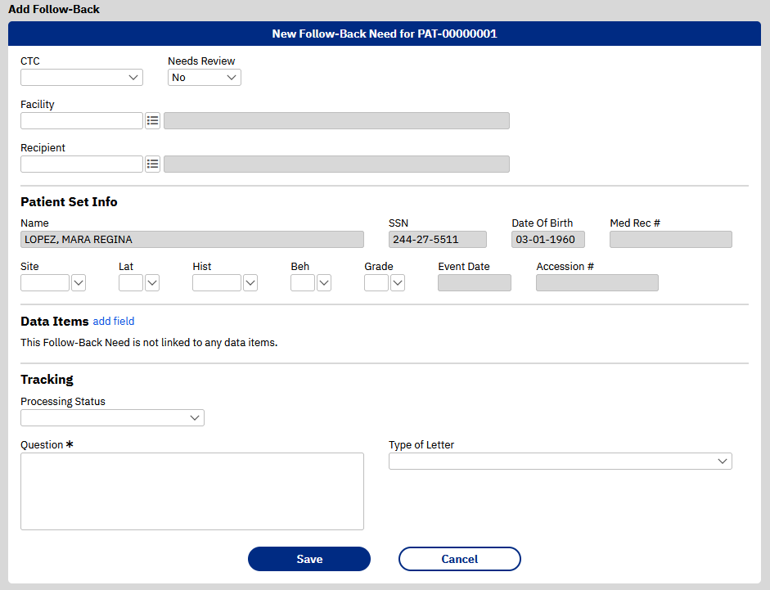
SEER*DMS
Follow-back
Processes
August 30, 2022

Slide 4

SEER*DMS Workshop:
Follow-back
Introduction
Registry Survey:
  Definition of Follow-back
  Common Follow-back Use Cases
Current Landscape:
  SEER*DMS Tools related to Follow-back
  Registry Processes
2022-2023 Development Projects related to Follow-back:
  Data Receiver System (Phase 1)
  New SEER*DMS Tools
Next Steps:
  Consider organizing a Follow-back workgroup

Slide 5
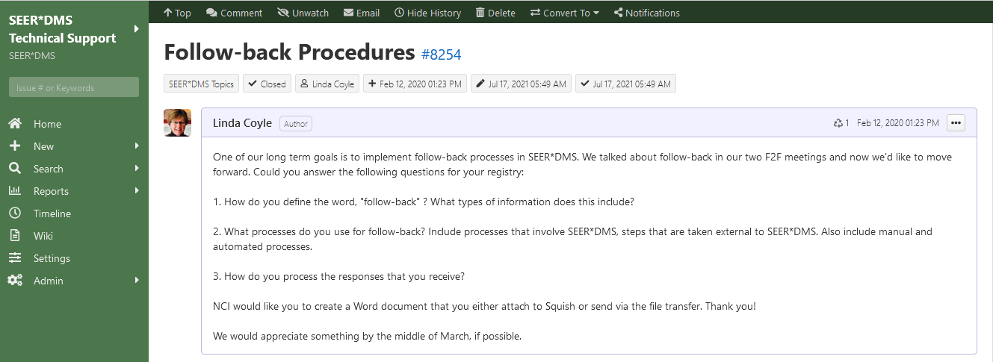
Introduction
Adding new follow-back tools in SEER*DMS has been on the SEER*DMS road map since the 2018 F2F Meeting. Requirements gathering started in 2020. Registries responded to the Squish issue shown below and provided their definitions of follow-back and descriptions of their current processes.

Slide 6
Introduction
Feb 2020 thru today….reviewed and categorized the registry content related to follow-back. Aligned the requirements with the project roadmap and priorities. Moved other priorities forward so that we can now address follow-back in 2022-2023.
Priorities & Achievements 2020-2022
Update from Struts 1 to 2 | High priority effort to update web tier; required to eliminate vulnerabilities
Auto-consolidation Improvements | Added rules based on SEER coding manual; and known over unknown for all abstract fields
Integration of Path Extraction API | Auto-coding of site, histology, behavior on path reports using Natural Language Processing (NLP)
Usability Project | Improvements to user interface based on usability studies
Registry Onboarding | Massachusetts (2020), Texas and Illinois (2022) ! Arkansas will be live in October 2022; Michigan by early 2023. Work with California to start in 2022.
Real Time Reporting | Update SEER*DMS workflow to build CTCs from path to reduce reporting delay
Security Assessments | Continual and sustained level of effort related to security initiatives and requirements
Enhanced Dashboards | Released new dashboards for Edits and Possible New Cases.
Support for New Data Sources | MU2, Pharmacy, Claims, Radiology Reports
Annual updates | Support new NAACCR versions & changes to submission requirements.

Slide 7
Introduction
2022-2023. We now have resources to dedicate to Follow-back and, as we will discuss, it aligns with SEER development efforts. Let’s continue our discussion by reviewing the Registry Survey.
Introduction
Registry Survey:
  Definition of Follow-back
  Common Follow-back Use Cases
Current Landscape:
  SEER*DMS Tools related to Follow-back
  Registry Processes
2022-2024 Development Projects related to Follow-back:
  Data Receiver System
  New SEER*DMS Tools
Next Steps:
  Consider organizing a Follow-back workgroup

Slide 8
SEER*DMS Definitions
Abstract Facility Lead (AFL)
  An AFL is meta data that is auto-created when a pathology report, case finding record, death certificate or other source record indicates that an abstract is expected for the facility.
  An open AFL indicates that an abstract is needed; the AFL is closed when an abstract is received or if the registry determines that it is no longer needed.
  Registry-defined rules are implemented to auto-create and auto-close AFLs
AFL Manager
  A module in SEER*DMS for registry staff to manage AFLs from path reports and other records excluding death certificates.
  Registry staff can view listings of open AFLs by facility, year, processing status, and many other attributes
DC Manager
  Same functionality as the AFL Manager but it only shows AFLs from death certificates
  Generates registry reports specifically designed for death clearance
Follow-back Need (FBN) and FB Manager
  Follow-back module was designed for registry staff to submit questions or comments to abstractors.
  Two registries have used automated processes to auto-create and auto-close FBN, but nearly all are created manually.

Slide 9
Summary:
How do you define follow-back?
Casefinding
  Requests for abstracts based on pathology, radiology, death certificates, indication that patient has history of cancer, and other sources.
  Not mentioned in 2020 but may also include reports based on review of hospital completeness measures. Example: CDRI Year End Hospital File Processing
Quality Improvement Activity
  Discrepancy Reports
  Request for Missing Data Items
  Feedback to abstractors (eg, abstractor review conducted by SHRI)
Providing Data Back to Hospitals
  Treatment provided at other facilities
  Follow-up information

Slide 10
Summary:
What are your follow-back processes?
Casefinding: (an abstract is needed from a hospital)
  Generate a list of SEER*DMS Abstract Facility Leads (AFLs)
  Automatically pull the AFLs into SEER*Abs
  Use an external, commercial tool like Excel to create a list
  Use an external system maintained by the registry to handle follow-back processes for casefinding

Slide 11
Summary:
What are your follow-back processes?
Quality Improvement for Existing Records
  Sending US mail or fax to physicians or facilities
  Calling physician offices or hospitals
  Sending email to physicians or facilities
  Interact with an external system to enter questions and queries; this may include extracting data from disease index systems to search for patients not in SEER*DMS
  Create list from SEER*DMS FB Manager. This may be a CSV file that is sent directly; or used as data for a report formatted via Mail Merge
  External system maintained by registry that reviews source abstracts for missing data items and automatically sends notification to the source facility
  Use an external, commercial tool like Excel to create and manage a list
  Create review tasks in SEER*DMS for review by registry staff

Slide 12
Summary:
What are your follow-back processes?
Providing data back to abstractors or hospitals
  Secure email (eg, generate listing from SEER*DMS data search and sending as an attachment
  Anything else?
    Do registries use system extracts to send record data to hospitals?
    Do registries use system extracts to send consolidated data to hospitals?
    How are data transferred?
    Other?

Slide 13
What processes do you use to provide data to hospitals and abstractors?
Name & Registry | Comment
April (NY) | In last few years – more path results. Using SQL queries to extract from DMS. Produce Excel spreadsheets and provide them to field reps. A large number of FB to physicians. Use similar process, but also have a web application that physicians use. Load into that system and physician can enter answers electronically. Also mail forms to physicians. NY does a lot of external processes.
Marina & April | FB to physicians – casefinding? April responded that it is mostly casefinding.
Marina & April | For quality FB – is it a form or narrative? April responded that the web application is based on NAACCR data items. And there is validation; when paper is sent then there are a lot of blanks. Often need treatment information for melanoma and prostate cases. Electronic reporting module has different modules based on cancer diagnosis.
Marina & April | Do you send data back to facilities? Generally only provide back what we receive
Michelle (KY) | KY uses a secure File Exchange Server
Bobbi (IA) | All data exchanged with hospitals is via an MFT site – secure data exchange. Any forms, memos, questions go back and forth through this secure file exchange. Create Excel from AFLs for case finding. Quality questions about specific cases – we create a FB and either create mail merge or create Excel from FB manager. For physicians – create mail merge file to send to physicians. Requests for abstracts for facilities that use SEER*Abs – it is pulled into SEER*Abs.
Jason (IA) | Follow-up information or data request – created through data search SQL. Extract and post to secure file exchange. Most facilities have access to a secure transfer site. Can also create unique URL + password that can be sent.
Lyn (GA) | Also have a secure portal. Create lists from AFL manager; create DCO lists that go back to the facilities. Also generate lists from the AFL manager for regional coordinators (have not received abstract for a path report).
Lyn (GA) | Interested in FB manager to ask questions. Mainly need for FB if we sent list and haven’t received a response; want to ask the status.
13

Slide 14
What processes do you use to provide data to hospitals and abstractors?
Name & Registry | Comment
Robin (GA) | Sometimes have questions – for example, the abstract text doesn’t support coding; missing treatment; ambiguous information. Generally, the CTR would forward it to a supervisor and the supervisor sends it to the regional coordinator. Prefer the chain of communication so that it goes through a supervisor.
Cathy (CT) | CTR posts the FB lists to a secure ftp site. We also send formatted follow-up lists to hospitals, which are also posted to the sftp site. Most treatment information is requested by telephone from the hospital registrars. To clarify: the follow-up we send contains updates for the hospitals to import into their databases.
Kacey (UT) | We use the FB Manager for the processes described by GA. The editor enters a FB need asking for clarification. We use it as a way to send information back (if we changed histology, etc). We generate those lists once a month. An editor enters it. A manager reviews the questions before they are sent. They are sent thru a secure box folder; used for all facilities.
Ginger (NM) | We have a follow-back letter in SEER*DMS. The editors can create it and send to a registrar, hospital registry, physician… These are currently mailed and this is something that will need to be changed because recipients are no longer working in their offices.
Ginger (NM) | NM does provide data back to hospitals. The data we provide back are provided through updates that we send to the facility via a secure file transfer.
Ginger (NM) | Only 2 people send inquiries. No review by managers because NM is such a small registry.
Jennifer (SE) | Monthly pull list queries that registry staff use. Registry staff login to the hospital systems. We report if they send an abstract is the same as another case; or questions about reportability. We produce Excel reports for registrars and our staff. Registrars have access to a secure file transfer. We also provide a web app so that the registrars can see the data related to cases that they reported. We generate FBNs for physicians. Editors create them. They are reviewed, create mail merge, send via US mail and ask for a fax in return. On a quarterly basis, ask MDs about race of patients. That is done in Access.
14

Slide 15
What processes do you use to provide data to hospitals and abstractors?
Name & Registry | Comment
Jennifer (SE) | We have reports that go back to the hospitals. SE probably answered survey in a limited means because we weren’t thinking of casefinding. We have expected abstract reports that we post on a secure web app. Hospitals can login and see patients and tumors that their facility has reported.
Robin (GA) | I routinely received requests for treatment information (every 4-6 weeks; long lists). That’s the type of information that gets sent back to the facilities. Would want to automate that process.
Erin (MN) | For MN--- We use FB for hospital registry QA, chart reviews needed for possible missing cases, personal reminder that there should be a future case coming in (example-a case found during a chart review and that registry struggles with casefinding), questions that I have or that I want to send to other staff. I try not to keep data outside of DMS, but other staff might keep separate Excel sheets. we send anything with private data via secure email, encrypted emails, secure fax, also some of the staff have access (sign in) to a facilities secure email portals. The path and abstracts come via SFTPs.
Robin (GA) | Would not release facility information but would send consolidated treatment data.
Lori (IL) | In Illinois, facility-specific information is considered confidential under Illinois law so we don't share information back to facilities.
Jennifer (SE) | Jon (IT) updated the SE application so that it pulls data from DMS.
Cathy (CT) | We provide follow-up information (DOLC, VS) to hospitals. Labor intensive using SQL queries. Use a dot net application created locally that is acceptable to Metriq, CNET. Would like to get those formatted reports from SEER*DMS.
Scott (CA) | We have shared follow-up. CNEXT and Metriq process these files.
15

Slide 16
What processes do you use to provide data to hospitals and abstractors?
Name & Registry | Comment
Jennifer (SE) | Seattle has the same for CNET, Metriq, and Oncolog
Mona (MN) | we had requests from several software vendors for followup info (death info), this year. Our vital records department are going to be providing those. I know one of the facilities was getting them quarterly and more recent than the death records we have in the registry
Tina (LA) | We send FUP similar to what SE and CA described. We created a process where the hospital sent certain data items and we returned data for patients that “belong” to that facility.
Tina (LA) | Brent created a process to create the files in the proper format.
Lori (IL) | llinois Vital Records provides a portal with a login/password for hospitals to gain access to death information. Those data don't belong to the cancer registry so we can't provide it, but they can.
Randi (ID) | We recently had hospitals requesting follow-up information. Desperate for DOLC and VS. We worked with a facility that uses Rocky Mtn. Rocky Mtn wants XML files. Ran into a problem where file created in DMS did not have facility identifiers. That would be our “ideal” that we would send a NAACCR file. (That would be IMS’s ideal also!!!) I’m not sure if we have heard from other vendors – ID will support any format they require. ID asked for a file of accession numbers and we sent back a file with DOLC and Vs.
Tina (LA) | We created a FB file. We have an import that supports this process to do this linkage. And we ask for FUP from them. Action: Linda will review and provide details.
Jennifer (SE) | Seattle uses one of the C/Net prescribed formats. For Metriq and Onco, we have a mostly blank NAACCR V13 flat file that has patient identifiers, hospital identifiers, DOLC and Vital Status. We don't provide tumor status or recurrence info.
16

Slide 17
What processes do you use to provide data to hospitals and abstractors?
Name & Registry | Comment
Linda (IMS) | Is there any registry that does not have secure email or secure file transfer? No one responded.
Marina (NCI) | Some registries have a secure system;
Ginger (NM) | Send paper for inquiries. Would prefer an interactive system.
Scott (Greater CA) | We use go anywhere. It supports file and secure email. We have facilities setup accounts. We have folders where they send files. We can provide forms (eg, editable PDF). Isolate the reports sent to each facility. The system supports all functionality in one system.
Scott (Greater CA) | For a vendor – can assign folders for multiple facilities. Or setup a single folder for a hospital manager.
Scott | Use secure email system to send one off messages to physicians or hospitals
Bobbi (IA) | We treat FBN manager as specific case, specific facility questions. We must send hard copies because we don’t have facilities setup in DMS for specific questions. We receive paper and upload as images. If we send requests for abstracts then we use AFL or DC manager to create listings. For hospitals – everything is through the secure file transfer (but not used for physicians)
Ginger (NM) | NM has same issue as IA with the physicians.
Bobbi (IA) | We have issues with getting physicians to respond. Too many to manage in the file transfer.
Mona (MN) | one issue with physicians and death clearance is the address on the DC is often not the correct address for the MDs
Jason (IA) | If we regularly receive data from them then we setup an account; but too much to do for every physician because of changes
17

Slide 18
What processes do you use to provide data to hospitals and abstractors?
Name & Registry | Comment
April (NY) | Are you asking if we’re interested in having a physician portal? NY physicians use a portal that supports many other processes.
Marina (NCI)
Ginger (NM) | Would it be possible to send an alert to the person or facility when we send them a follow back inquiry so they know to check the secure site?
18

Slide 19
Summary:
How do you process the responses you receive?
Automated processes used by two SEER*DMS registries:
  Receive file of updated abstracts
    Casefinding: the open AFL will auto-close
    Updates to data items: Two registries use a workflow to auto-close the SEER*DMS Follow-back Need
Abstractor or physician’s office provides information over the phone; registry CTR manually enters information into SEER*DMS
Use an in-house FB tracking system and make bulk updates to SEER*DMS.
Use a combination of SEER*DMS review tasks and a list maintained in Excel

Slide 20
Original Follow-back and Case finding Goals 2000-2005
Primary objective for original SEER*DMS development:
  Collect data required to support external processes used at the time
SEER*DMS modules created to track follow-back and case finding:
  Abstract Facility Leads (AFL) are meta data used for casefinding.
  Follow-back needs store questions and comments for hospital abstractors
  Use manager pages to monitor open AFLs and FB needs; and to create reports and listings customized for the registry.
    AFL Manager
    Death Clearance Manager
    Follow-back Manager

Slide 21
2022 Objectives & Plans
Reduce manual burden
  Streamline processes to reduce burden on registry operations & IT
Ensure quality across processes
  FB survey showed variation in the narrative, but distinct patterns
  Support processes that registries have in common
Increase availability of functionality to more registries
  Move some external processes into SEER*DMS so that all registries benefit
Current plans:
  Review and enhance SEER*DMS functionality
  Design and develop an ancillary system to interface with facilities that provide data to the registry

Slide 22
Discussion Notes:
Follow-back Processes
SEER*DMS Workshop
August 30, 2022
  Facilitated by Marina Matatova (NCI), Linda Coyle (IMS), Suzanne Adams (IMS)
  Participants include SEER registry, NCI Surveillance Research Program, and IMS staff.

Slide 23
What functionalities are critical or would be most useful?
What processes have changed since 2020?
Name & Registry | Comment
23

Slide 24
What functionalities are critical or would be most useful?
What processes have changed since 2020?
Name & Registry | Comment
24

Slide 25
What functionalities are critical or would be most useful?
What processes have changed since 2020?
Name & Registry | Comment
25

